Slide 1

Accelerating extinction risk from climate change
by Mark C. Urban
Science
Volume 348(6234):571-573
May 1, 2015
Published by AAAS

Slide 2
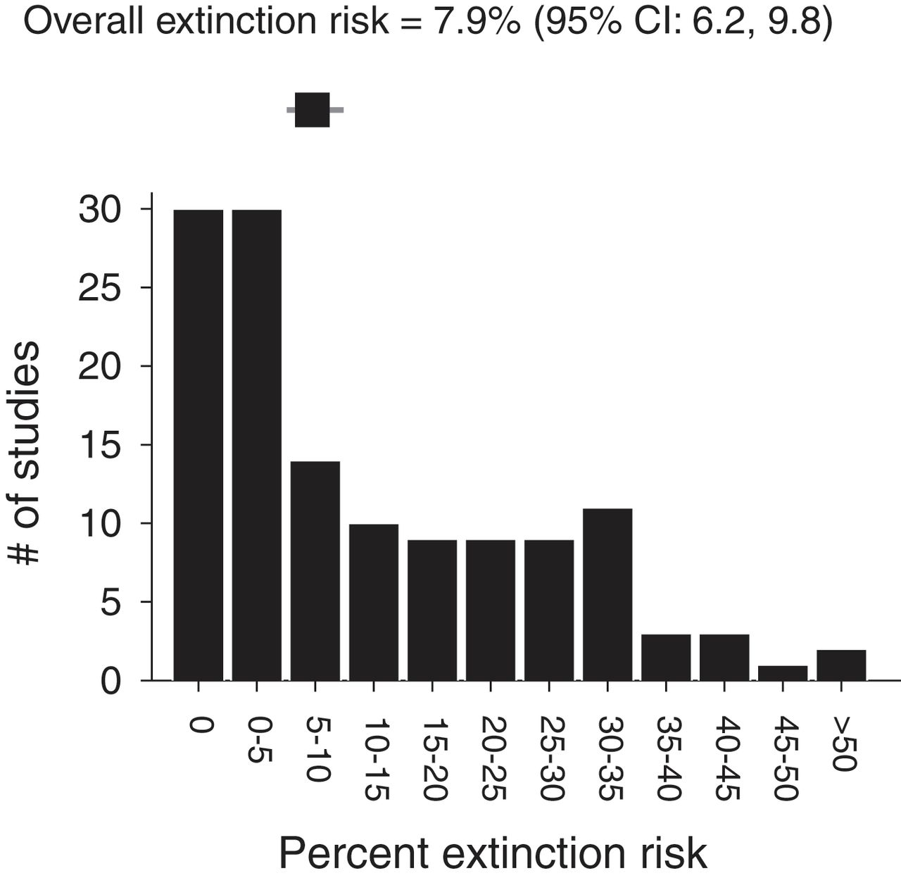
Fig. 1 Histogram of percent extinction risks from climate change for 131 studies.
Mark C. Urban Science 2015;348:571-573
Published by AAAS
Notes:
Histogram of percent extinction risks from climate change for 131 studies. Percent extinction risk refers to the predicted percent of species extinctions in each study, averaged across all model assumptions. The meta-analysis estimated mean with 95% CIs is also shown.

Slide 3
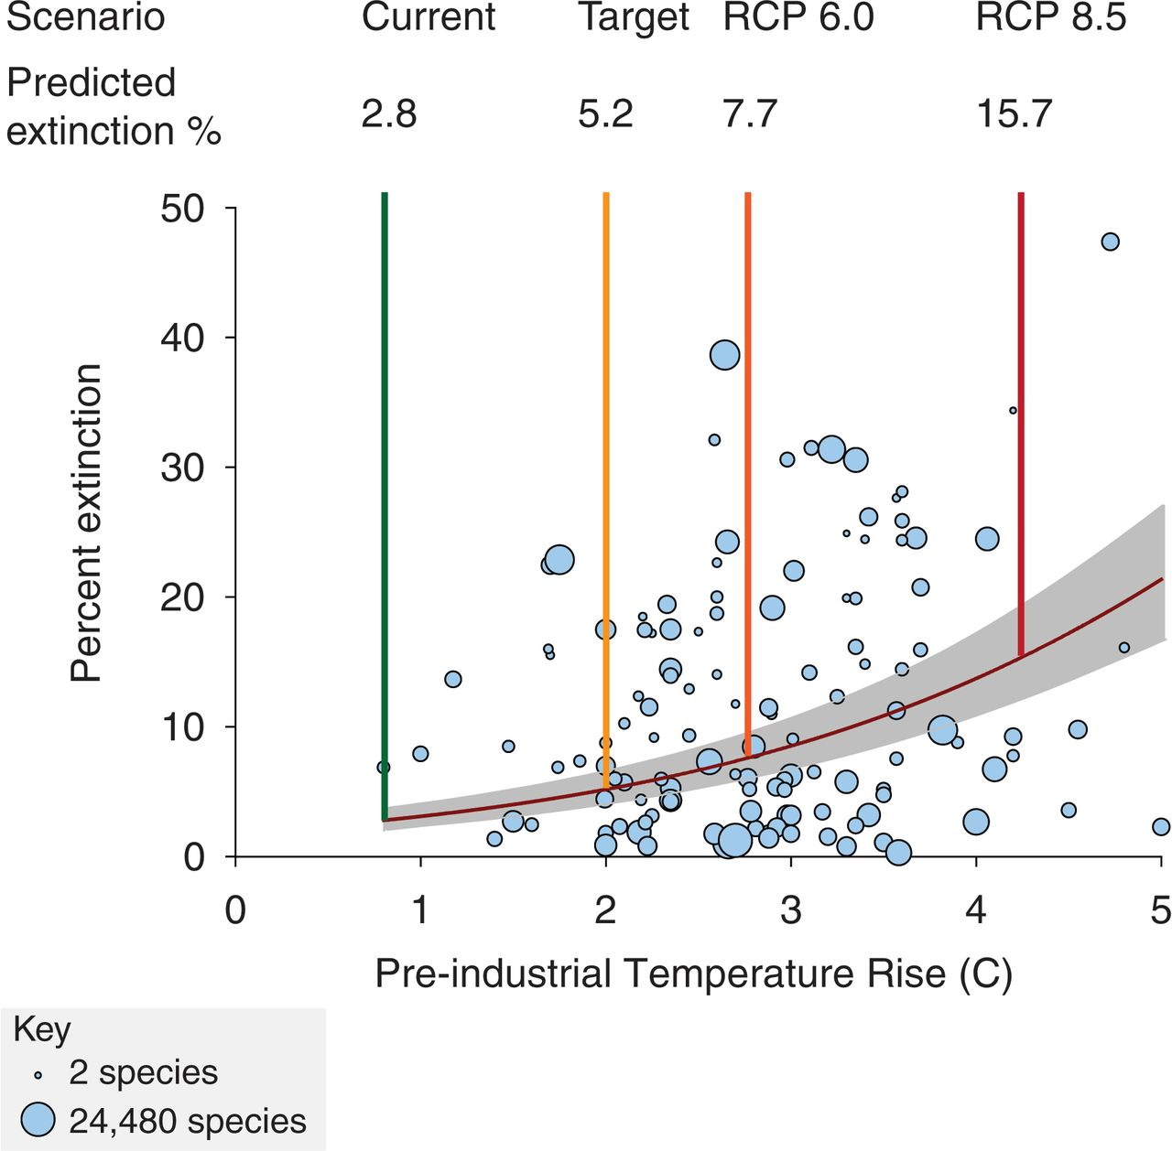
Fig. 2 Predicted extinction risks from climate change accelerate with global temperature rise.
Mark C. Urban Science 2015;348:571-573
Published by AAAS
Notes:
Predicted extinction risks from climate change accelerate with global temperature rise. The gray band indicates 95% CIs. Preindustrial rise was calculated by using standard methods (27). Circles indicate posterior means with area proportional to log₁₀ sample size (bottom left, key). Extinction risks for four scenarios are provided: the current postindustrial temperature rise of 0.8°C (5), the policy target of 2°C, and RCPs 6.0 and 8.5.

Slide 4
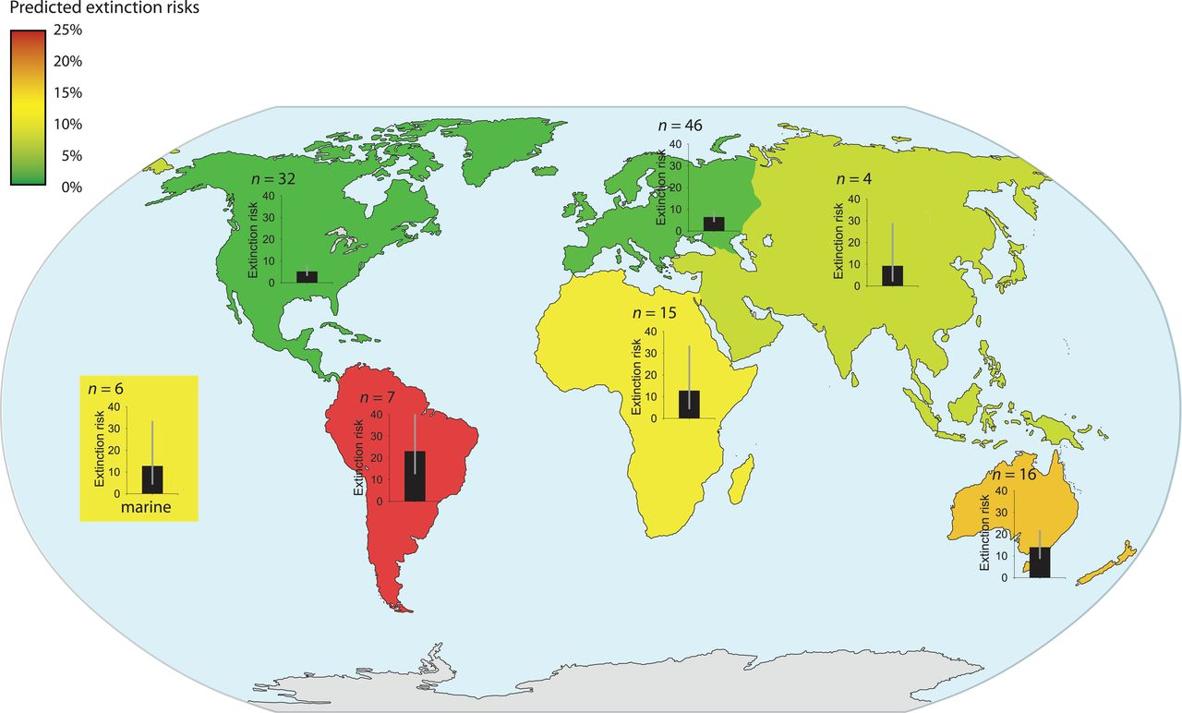
Fig. 3 Predicted extinction risks from climate change differ by region.
Mark C. Urban Science 2015;348:571-573
Published by AAAS
Notes:
Predicted extinction risks from climate change differ by region. The highest risks characterized South America, Australia, and New Zealand (14 to 23%), and the lowest risks characterized North America and Europe (5 to 6%). Colors indicate relative risk. Bar graphs with 95% CIs and number of studies (n) are displayed.

Slide 5
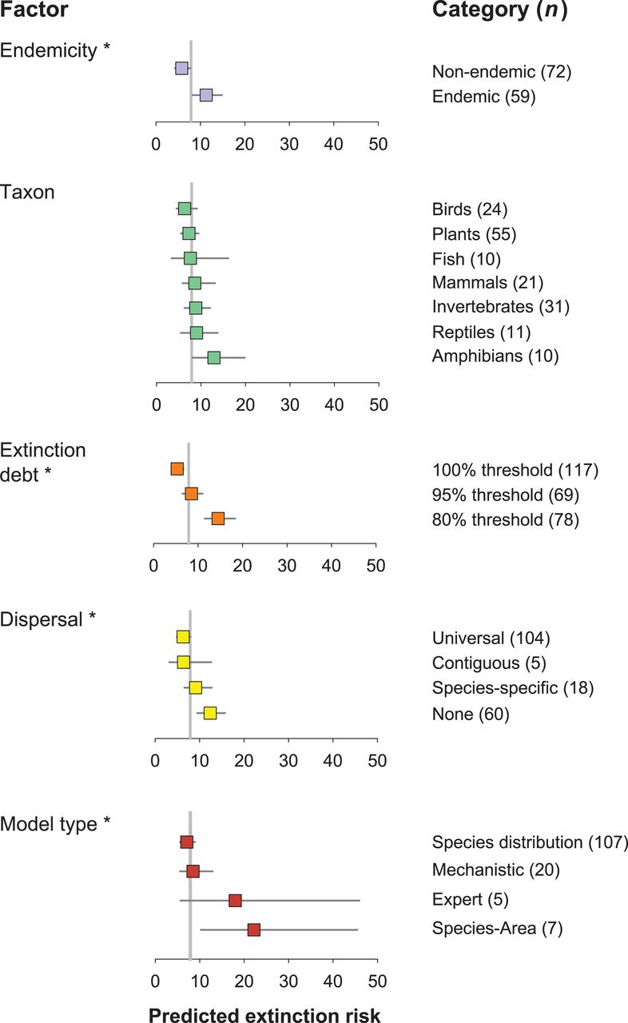
Fig. 4 Predicted extinction risks from climate change depend on model characteristics.
Mark C. Urban Science 2015;348:571-573
Published by AAAS
Notes:
Predicted extinction risks from climate change depend on model characteristics. The asterisk indicates model support (ΔDIC > 4) for each factor separately, and number of studies is included in parentheses. Categories within each factor are listed in order of increasing extinction risk. The gray vertical reference line indicates mean overall extinction risk. Bars represent 95% CIs.

